Slide 1
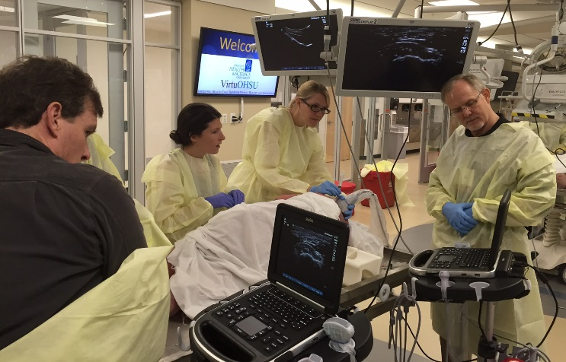

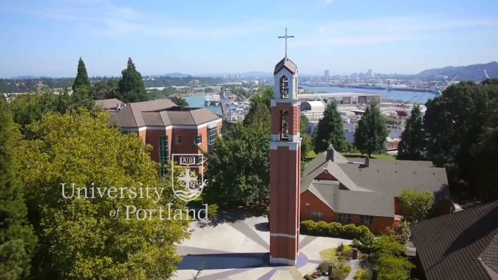
Southwest Washington
Sports Medicine Fellowship
Kevin deWeber, MD, FAMSSM, FAAFP, FACSM, RMSKS
Program Director

Slide 2
Overview
PeaceHealth
Residency
Fellowship
  Faculty
  Training sites
  Schedule template
  Salary and Benefits

Slide 3
PeaceHealth is a not-for-profit health care system with medical centers, critical access hospitals, medical clinics and laboratories located in Alaska, Oregon and Washington.

Slide 4
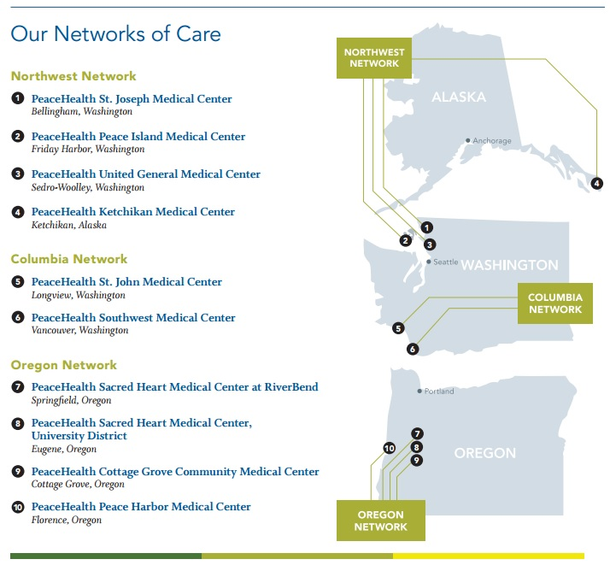
PeaceHealth Networks

Slide 5
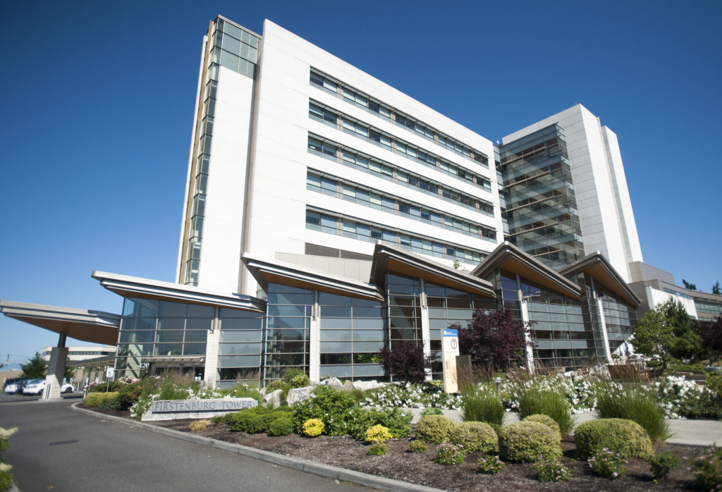
Southwest Medical Center
Note: fellows do not provide inpatient or labor/deliver care during training
Notes:
450 beds and Level II trauma center. Rebound Orthpedics’ main office is located in the Physicians Pavion. Fellows do not provide inpatient or labor & delivery care during their training.

Slide 6
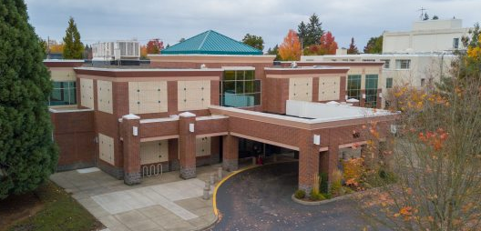
Family Medicine of SW Washington
Residency & Fellowship Clinic
24 faculty
24 residents
1 fellow
Specialties:
  Sports Med, Physical Therapy, OMT
  Integrative Med
  Ob/Gyn
  HIV, Addiction Med
  Pharmacology
  Behavioral Health

Slide 7
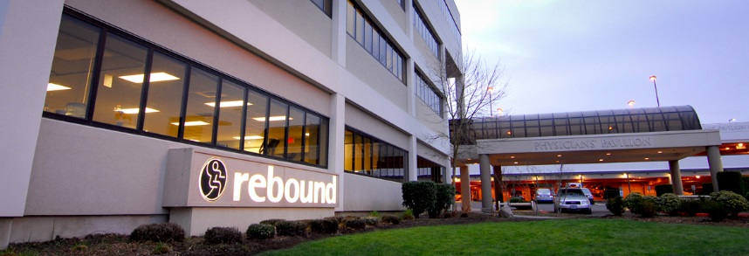
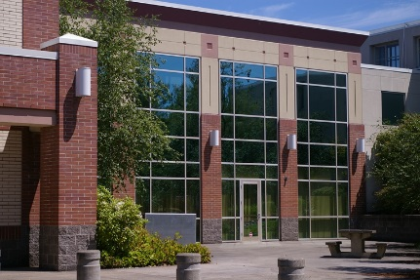



Fellowship Training Sites
Primary Care Sports Med:
  4 hd/wk
FM Clinic
  2 hd/wk
Orthopedics:
  1-2 hd/wk
Team Physician:
  2-3 TR clinics/wk + games
Didactics & Ultrasound
  1 hd/wk

Slide 8
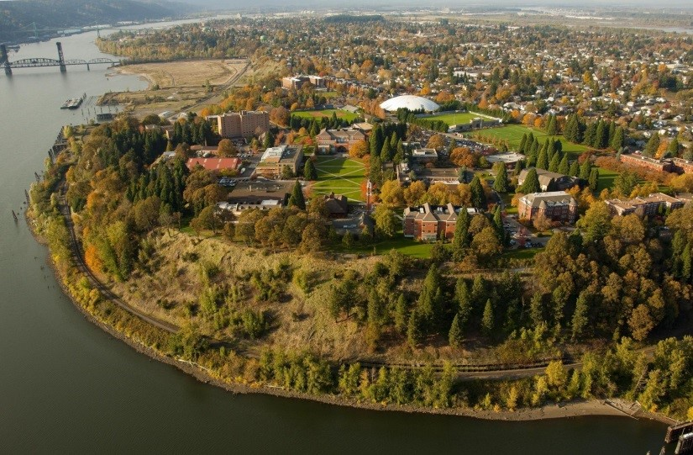

University of Portland
Team Physician experience, Div 1A
275-300 athletes
Sports:
  Soccer
  VB
  Basketball
  Baseball
  XC, T&F
  Tennis
  Rowing

Slide 9



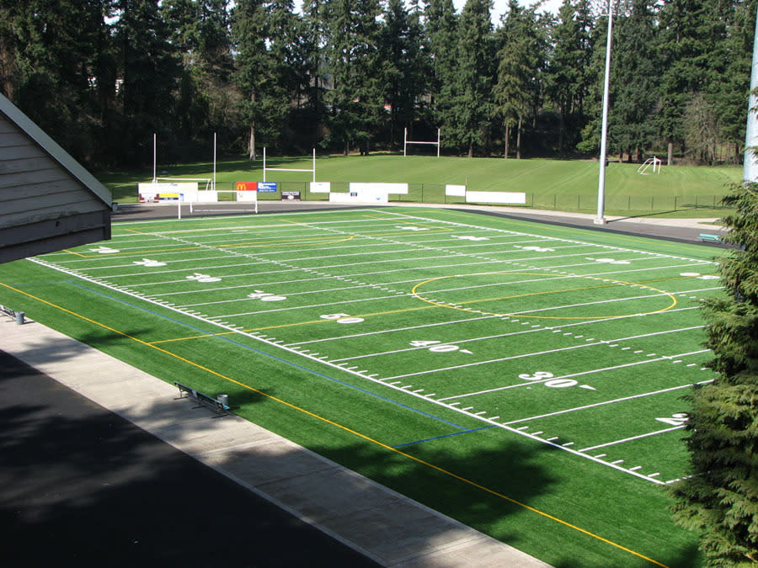
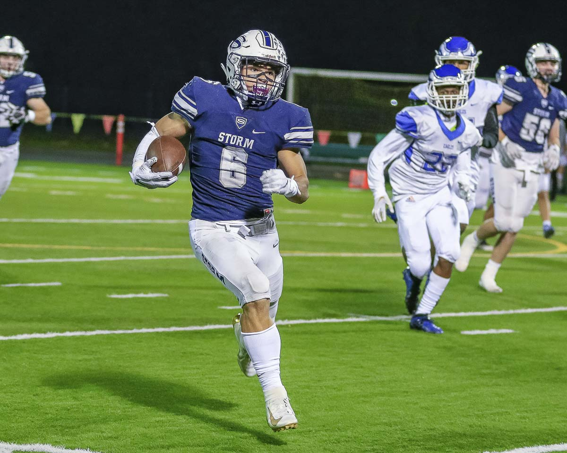
High School Football

Slide 10

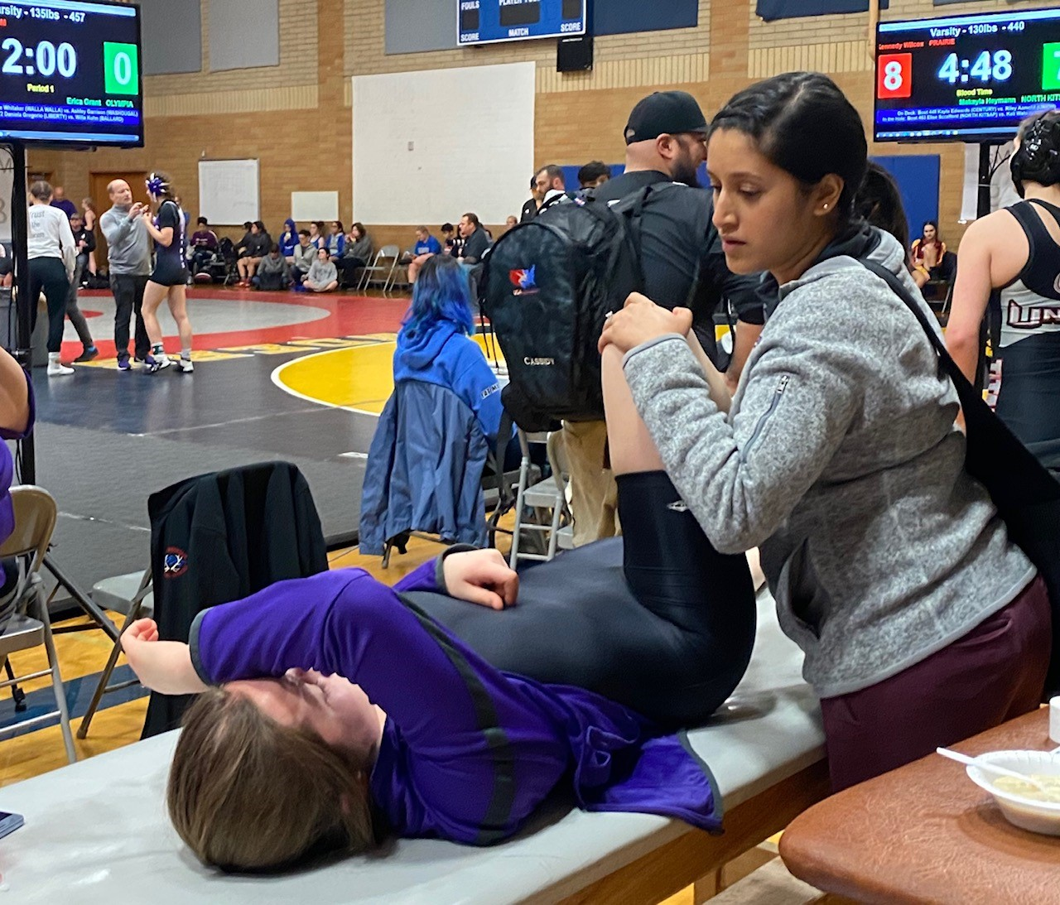
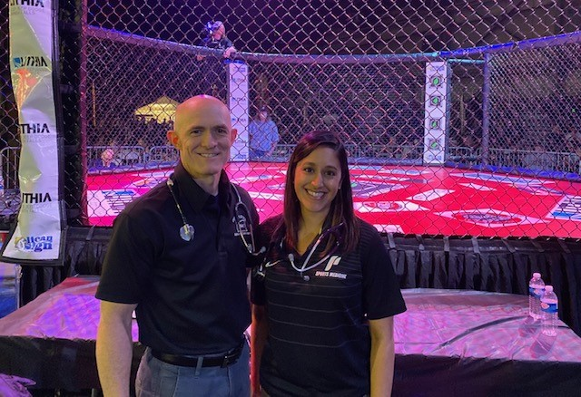
Other event coverage
Mass participation races
Wrestling tournaments
Optional
  MMA and boxing

Slide 11
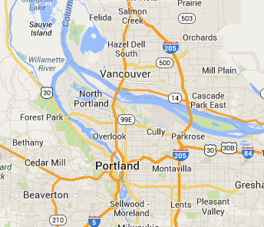
Where is all that?
80%
10%
10%
U of P
OHSU

Slide 12
Family Medicine Clinic
2 hd/wk at FMSW
  No patients empaneled
  May include OMT clinic for DO’s

Slide 13
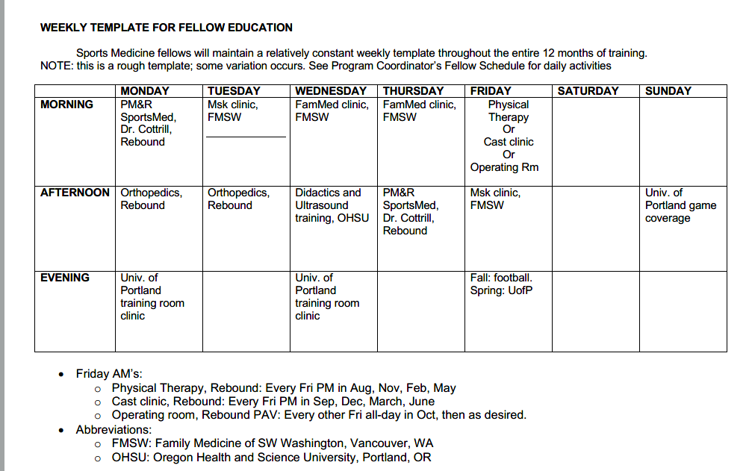
Weekly Template

Slide 14
Procedural Training
Diagnostic US
Interventional US
Landmark-guided procedures
Tenotomy
  Dextrose
  Blood
  PRP
Bone marrow aspirates and mesenchymal stem cells
Hydrodissection
Auricular acupuncture for pain
ECG in athletes

Slide 15
Procedure numbers
(averages, last 7 fellows)
US-guided injections: 188/year
Diagnostic US: 175/year
Landmark-guided injections: 104/year
USGI + DxUS = 363/year
  RMSKS® Benchmark: 150

Slide 16
Teaching Opp’s for Fellows
Lots of curbside Msk consults from residents/faculty
Resident cast/splint workshop
Resident US workshops
Residency/Fellowship didactic lectures
Mentoring at sports events
Cadaver injection labs (PA/NP students, residents, med students)
Teach Intro US at AMSSM/OHSU course

Slide 17
Key Faculty

Slide 18

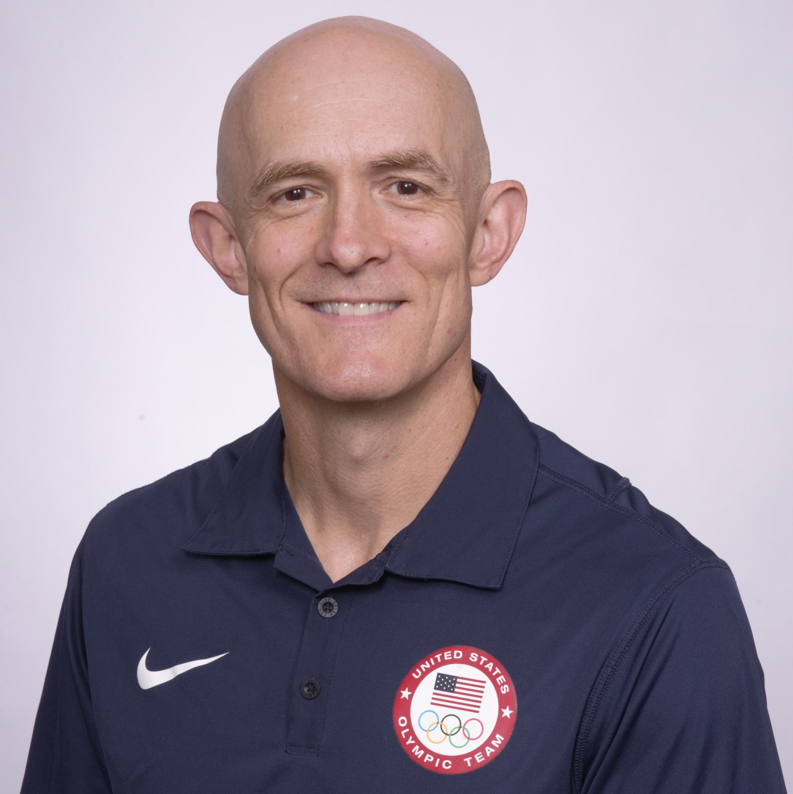

Kevin deWeber, MD, FAMSSM, FAAFP, FACSM, RMSKS
Prior Military Fellowship Director 6 years
  24 graduates, 2007-13
SW Wash. Program Director/founder 2015
Teaching US since 2008
  AMSSM West Coast US course director
US Olympic Medical Team 2012 & 2016

Slide 19
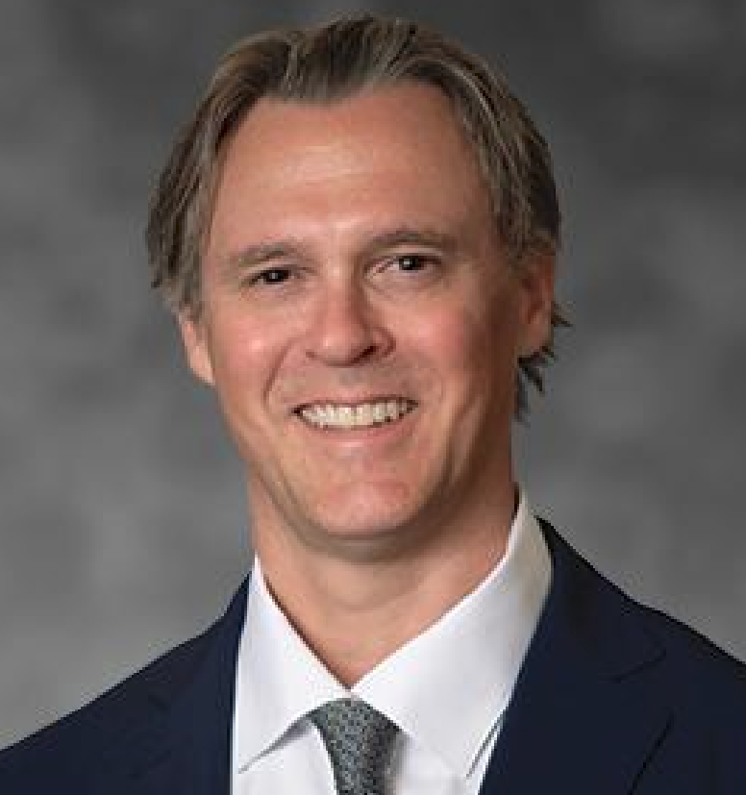


Jerod Cotrill, DO, RMSKS
PM&R and Sports Med
Rebound Orthopedics
USA Ski Team physician
Team Physician, Portland Trailblazers

Slide 20

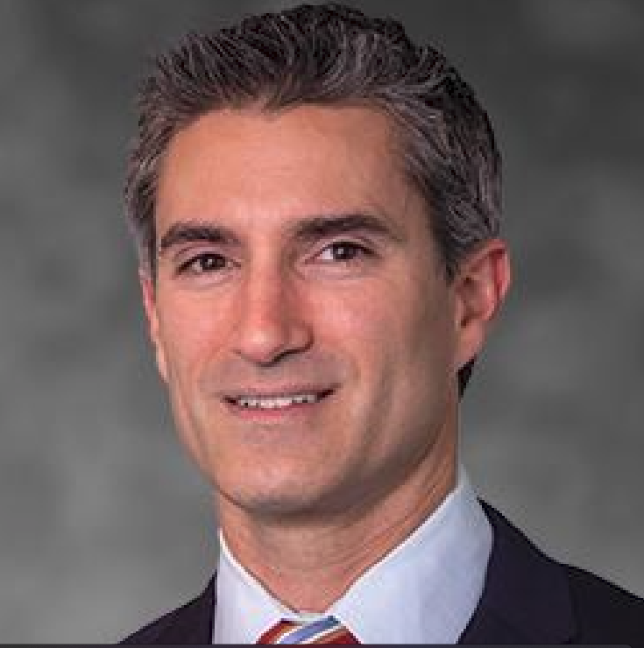
Jerome DaSilva, MD, FRCSC
Orthopedic Sports Medicine
Rebound Orthopedics
Team Physician, Portland Winterhawks hockey

Slide 21
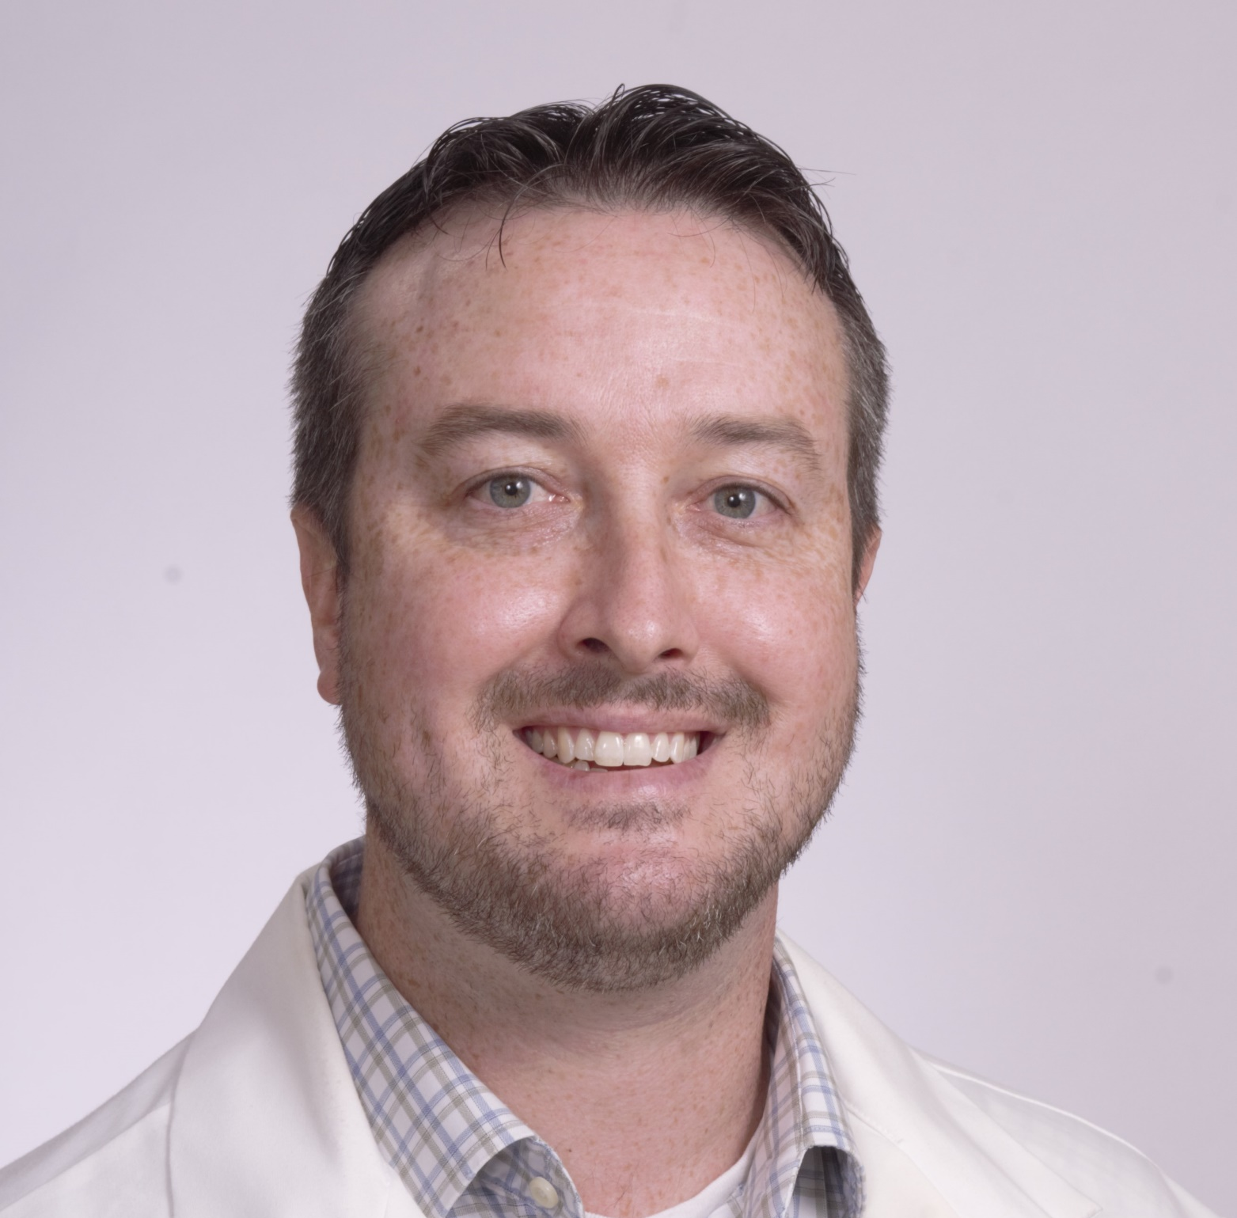
Brian Lowell, MD
Family Medicine, Sports Medicine
Fellowship/Residency faculty
Team Physician, Univ. of Portland

Slide 22
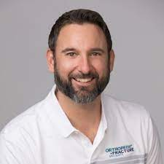
Brian Bettencourt, DO
Family Medicine, Sports Medicine
Head Team Physician, Univ. of Portland

Slide 23
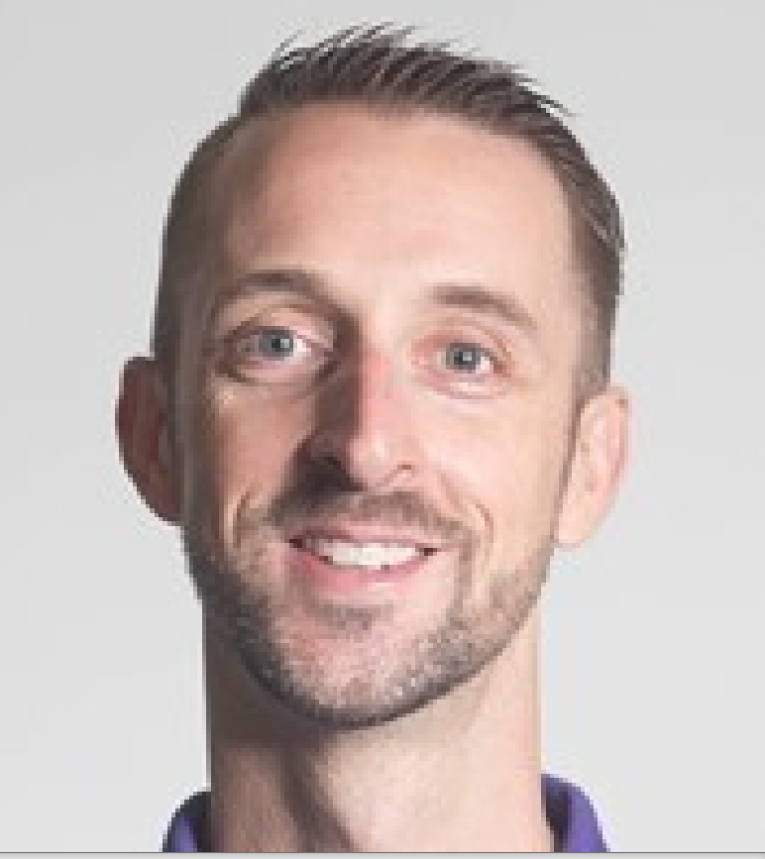
Sam Gay, ATC
Head Athletic Trainer, U. of Portland

Slide 24


OHSU Faculty
FM/Sports, EM/Sports
  Didactics, Cadaver USG injection labs

Slide 25
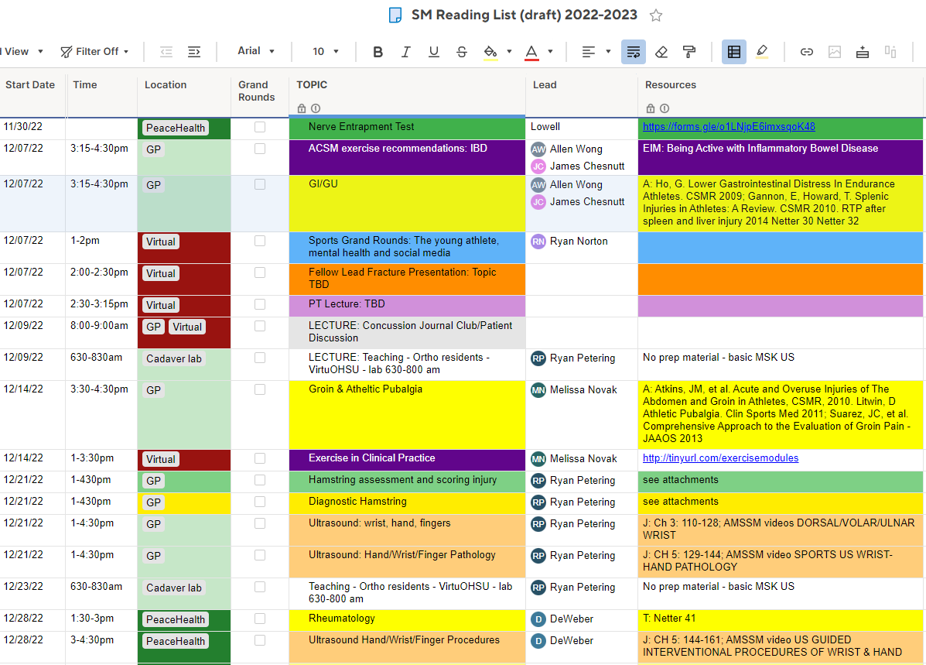
Didactics: sample from online spreadsheet

Slide 26
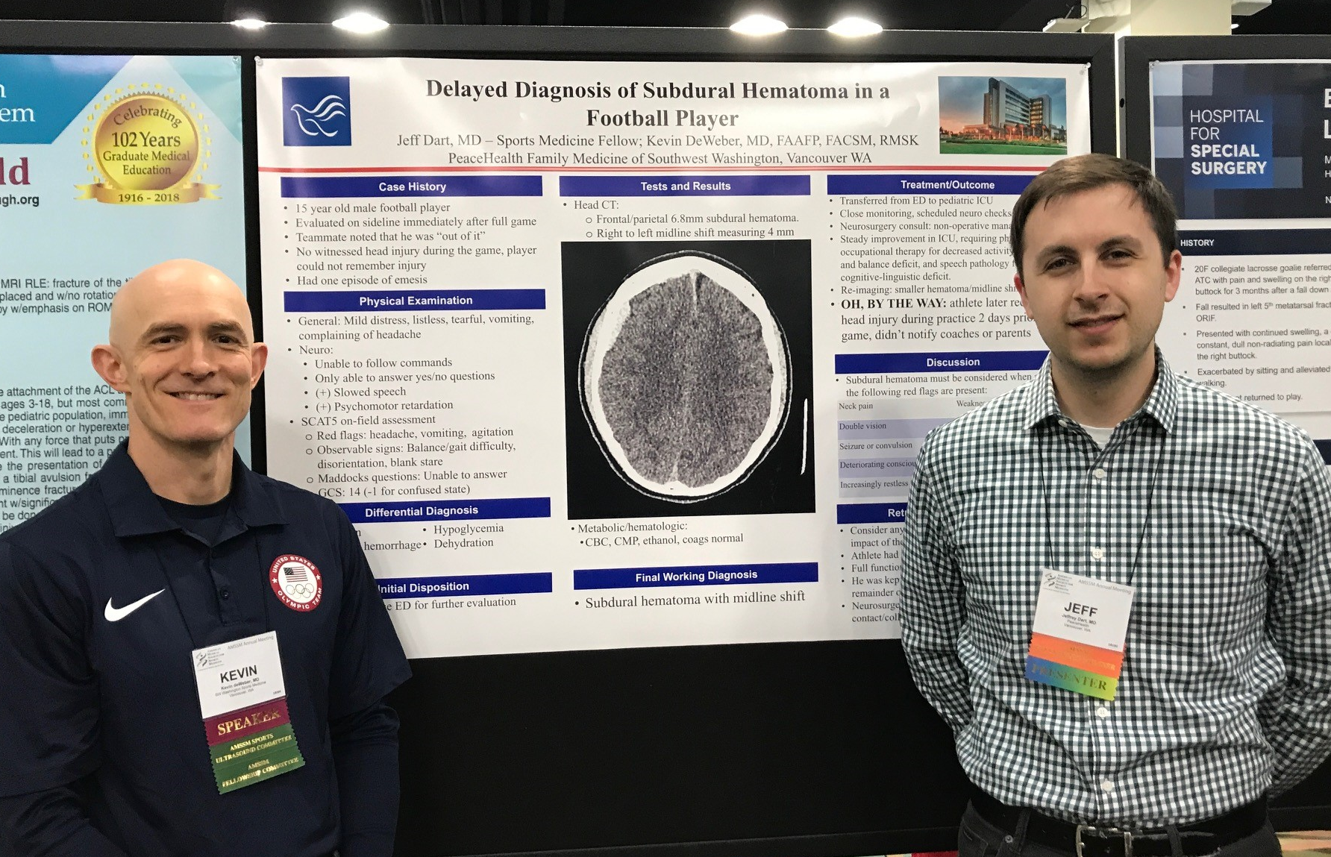
Scholarly Activities
Review article or book chapter, any topic
AMSSM case report
QI project
Other as desired

Slide 27
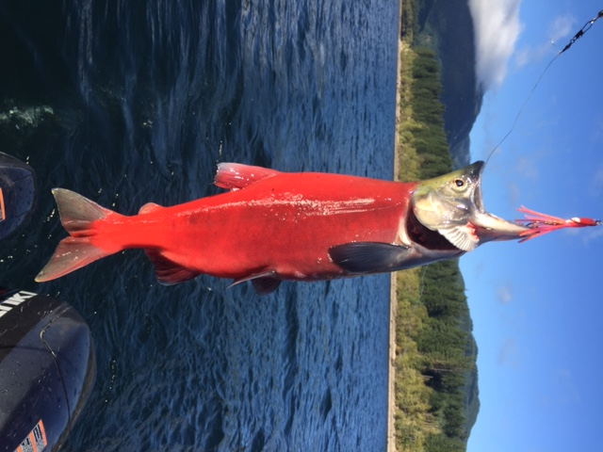
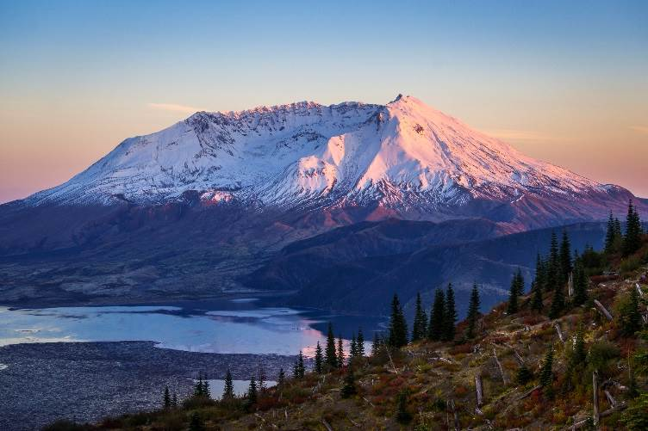
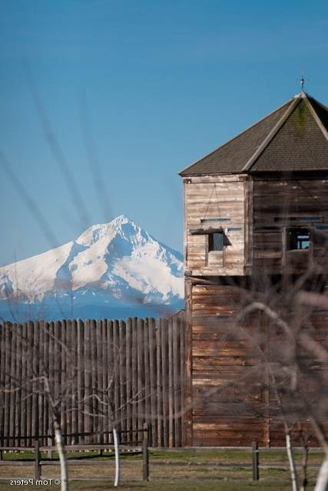
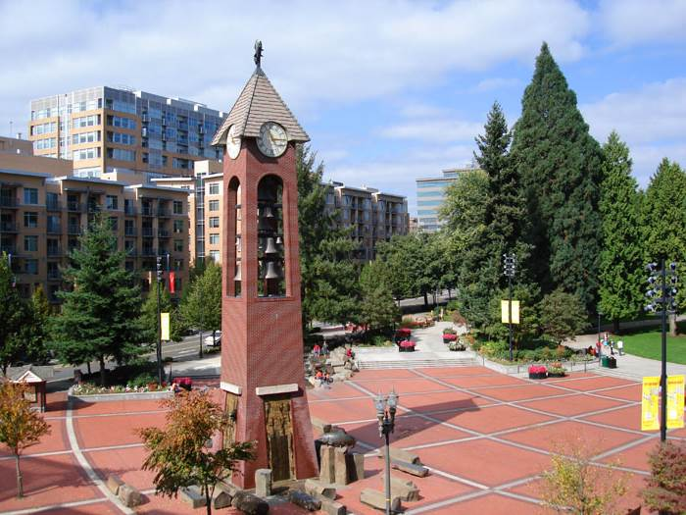

And in your time off…

Slide 28
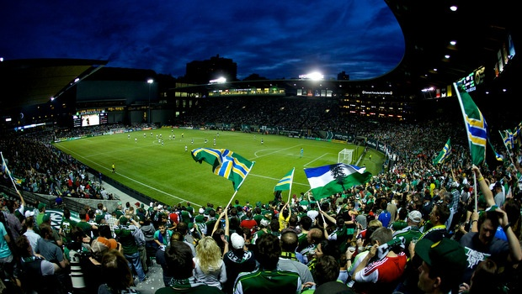
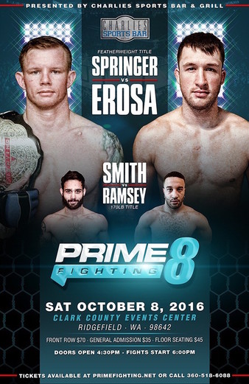
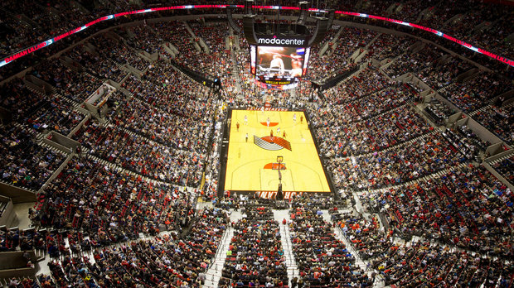

Slide 29
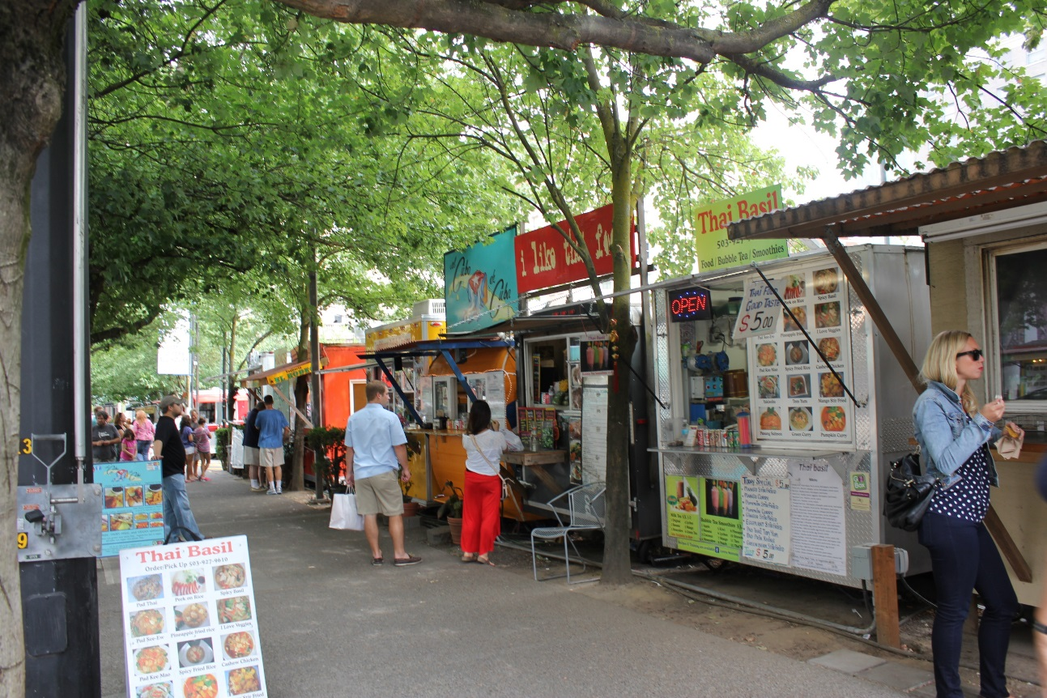
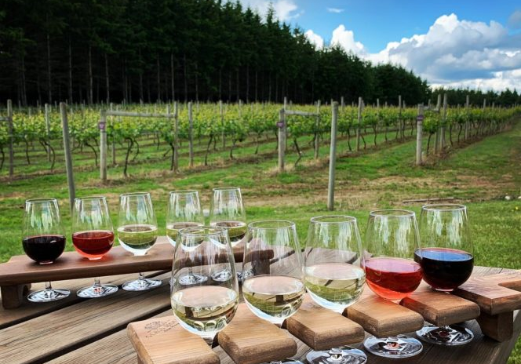

Slide 30
Salary and Benefits
$85,000/yr salary
28 days paid-time-off (PTO)
  21 days vacation/sick
  7 clinic holidays
Paid WA and OR licenses
Paid CME trips (doesn’t count twd PTO)
  AMSSM annual meeting
  Advanced Team Physician Course
Benefits…

Slide 31
Questions?

